Slide 1
Loftium – Project Overview
Problem Statement
Loftium seeks to maximize Airbnb revenue from private rooms
Desired Outcome
A predictive model that best estimates recurring Airbnb revenue

Slide 2
Loftium – Project Overview
Project Scope
Explore Loftium data
Evaluate Loftium’s existing model
Scrape for additional data
Develop alternative predictive models

Slide 3
Exploring the Data
Laying out assumptions
Phase 1: Currently limited to Seattle
Target: Expected Monthly Revenue (EMR)
Expected Daily Revenue (EDR)
Project Priority:
Predictive accuracy
Extra feature engineering
Statistical inference

Slide 4
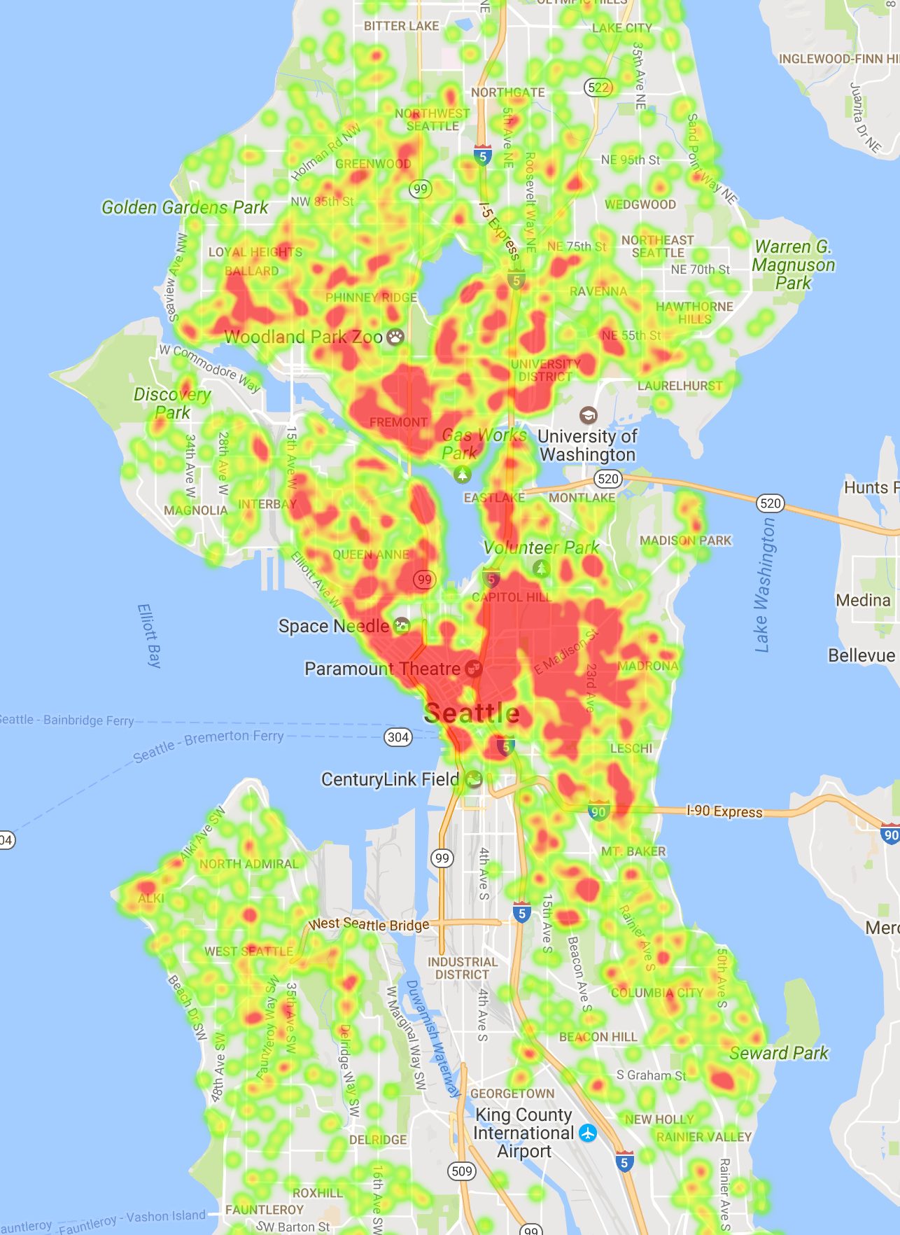
Identifying Hypotheses
Using initial hypotheses to define analytics strategy
EDR is driven by:
Location, location, location!
Seasonality
Host quality
Other features?
Density Heat Map
Seattle Airbnb Properties

Slide 5
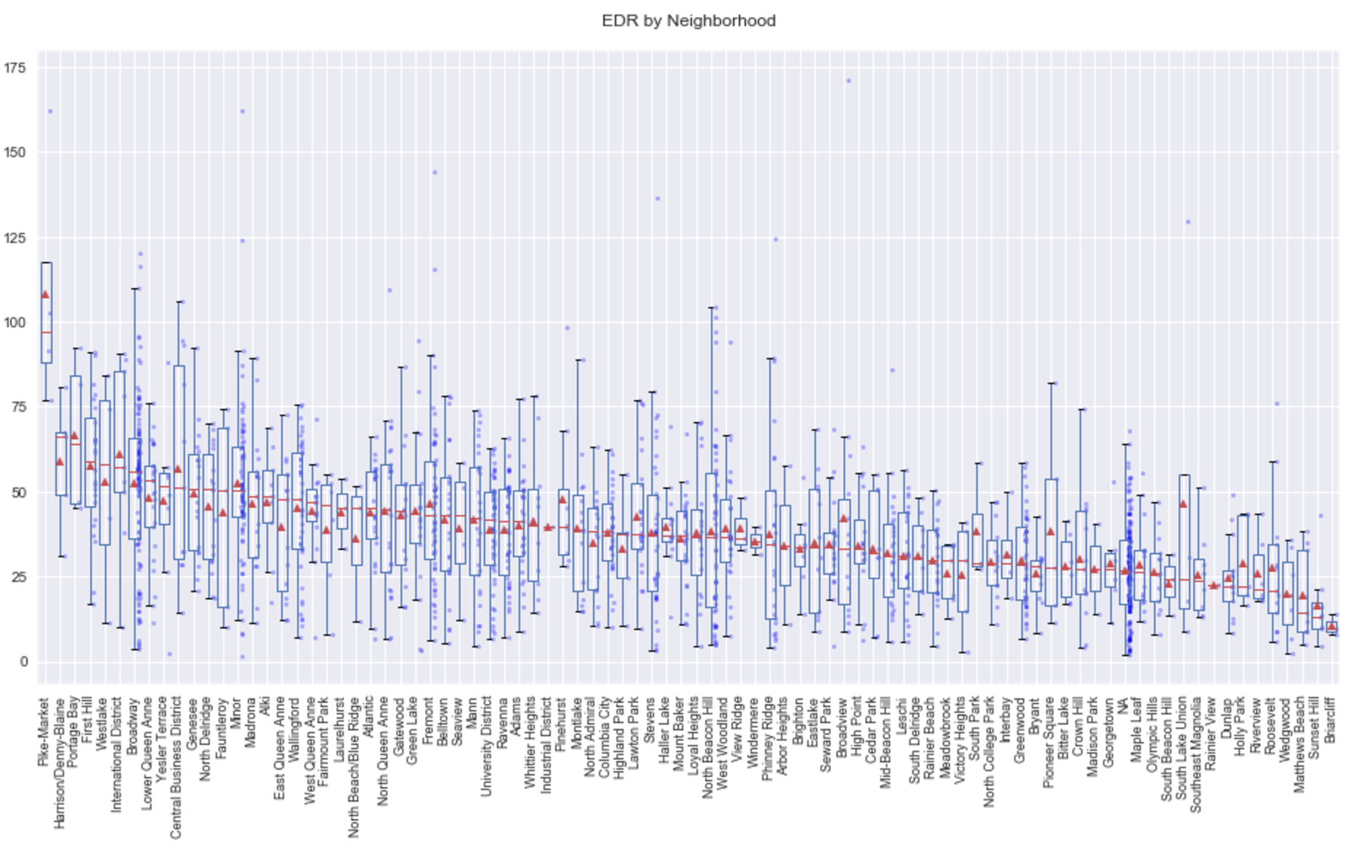
Location, Location, Location!
EDR varies by neighborhood … but significant variation per neighborhood!!!

Slide 6
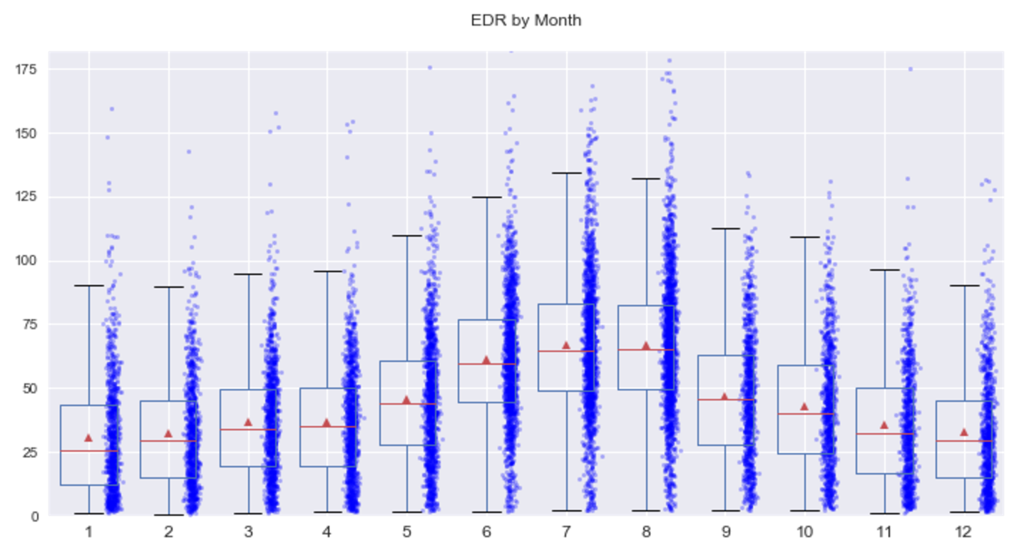
Exploring Seasonality
Significant seasonality impact

Slide 7
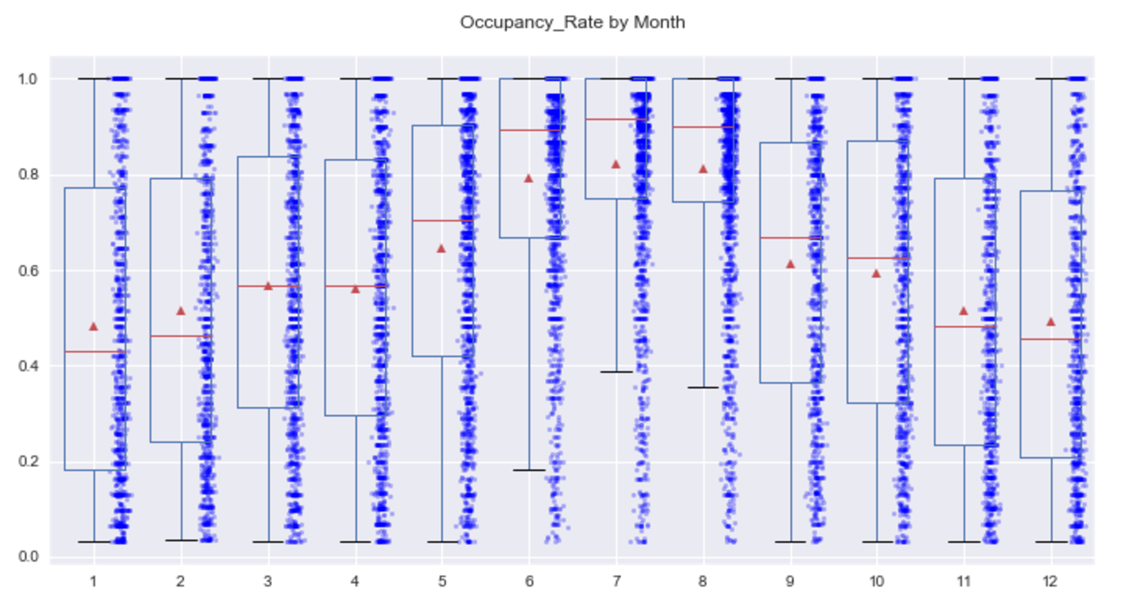
Exploring Seasonality
Seasonality impact on occupancy is more severe

Slide 8
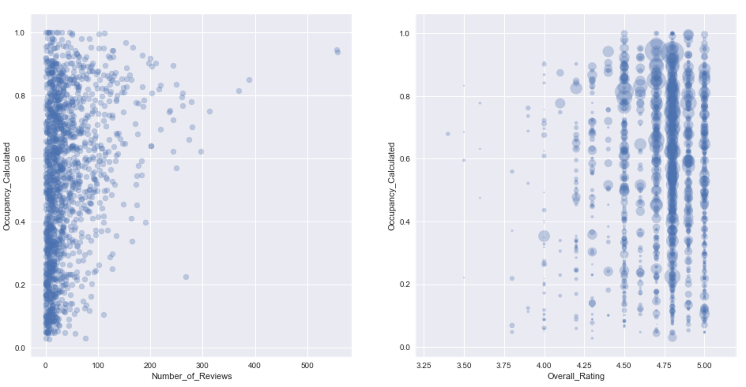

Exploring Host Quality
Occupancy increases with property ratings

Slide 9
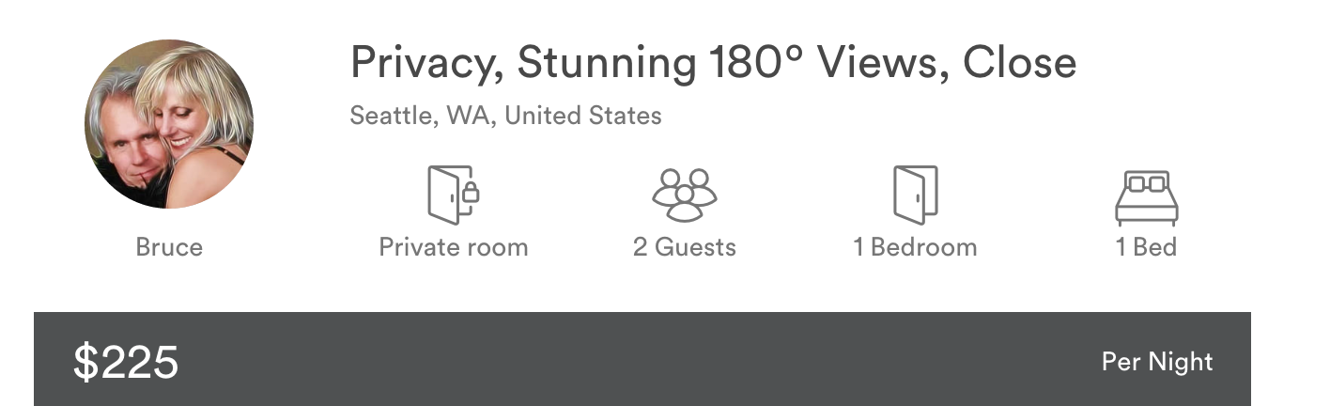
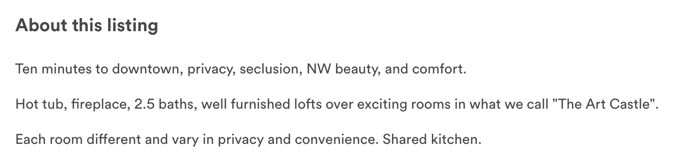
Finding Additional Features
Using NLP to identify additional meaningful features
Natural Language Processing

Slide 10
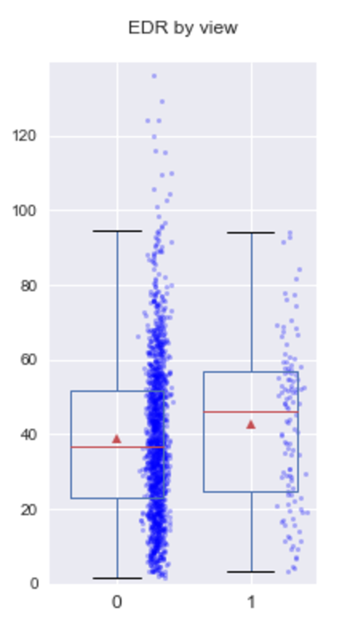
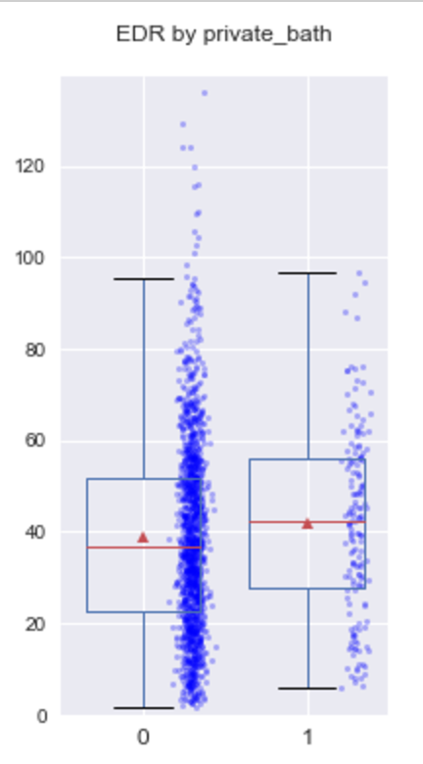
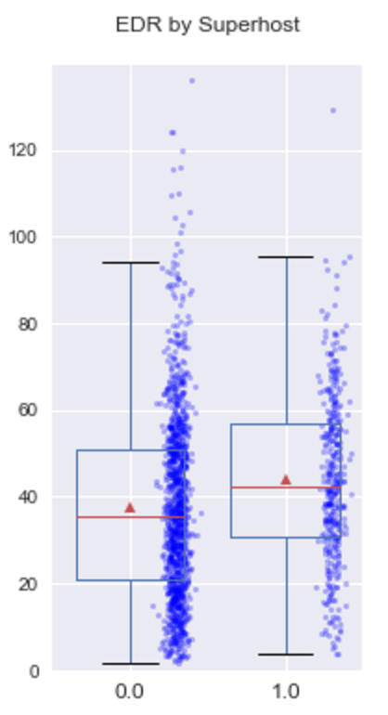
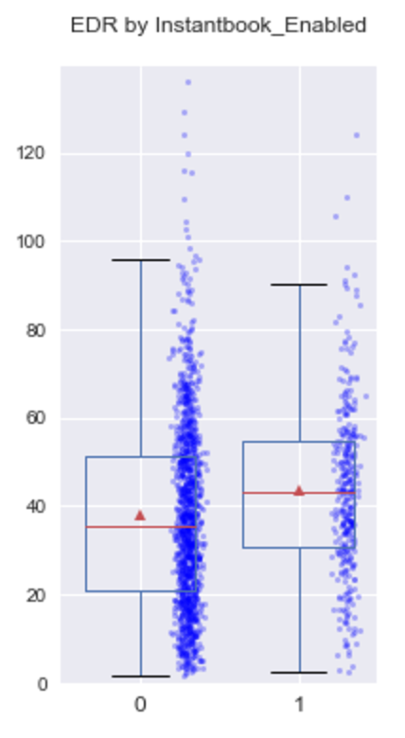
Finding Additional Features

Slide 11
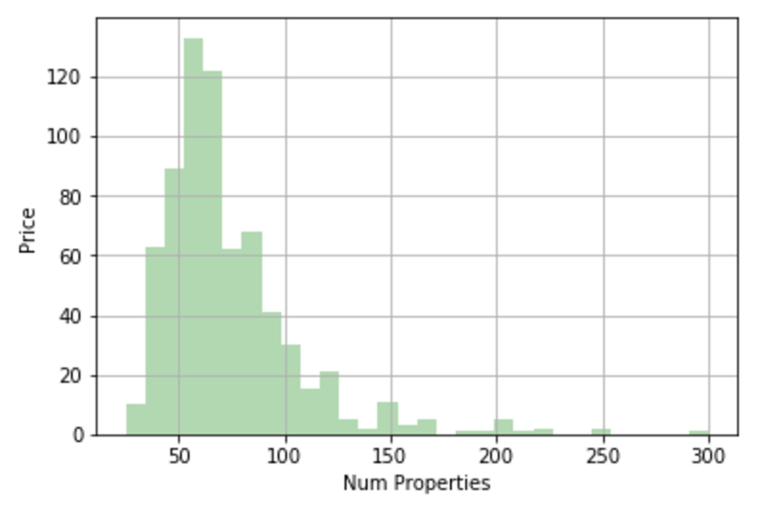
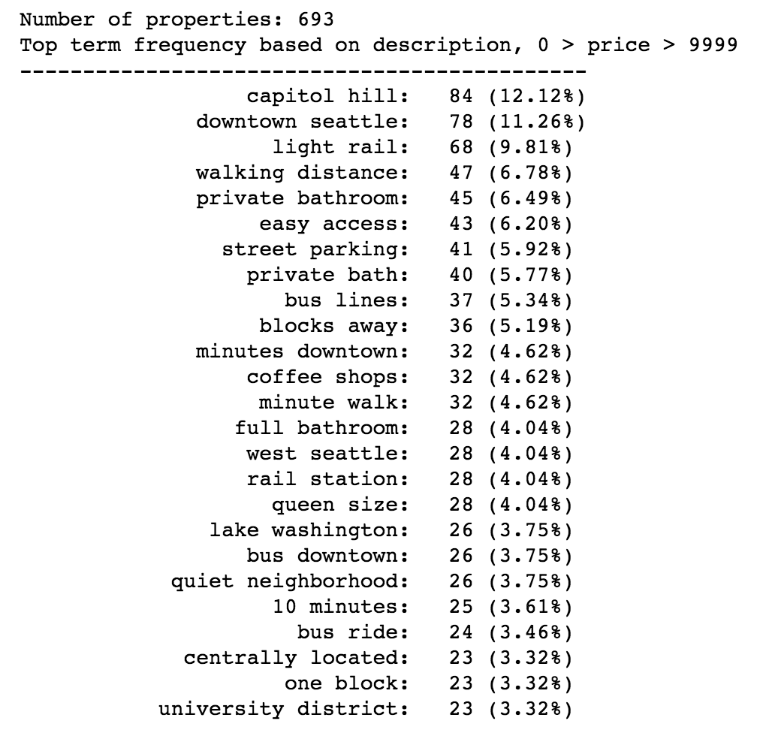
Text Mining

Slide 12
Text Mining
Bigram | Count | %
light rail | 14 | 30.43%
downtown seattle | 8 | 17.39%
rail station | 7 | 15.22%
clean quiet | 6 | 13.04%
university washington | 6 | 13.04%
walk othello | 5 | 10.87%
othello light | 5 | 10.87%
quiet cozy | 5 | 10.87%
quiet jewish | 5 | 10.87%
by bus | 5 | 10.87%
station 8mile | 5 | 10.87%
neighborhood quiet | 5 | 10.87%
walk seward | 5 | 10.87%
community just | 5 | 10.87%
jewish community | 5 | 10.87%
just 1mile | 5 | 10.87%
coffee shops | 5 | 10.87%
seward park | 5 | 10.87%
8mile walk | 5 | 10.87%
1mile walk | 5 | 10.87%
minutes walk | 4 | 8.70%
washer dryer | 4 | 8.70%
easy access | 4 | 8.70%
easy bus | 4 | 8.70%

Slide 13
Text Mining
Bigram | Count | %
private bath | 41 | 6.18%
light rail | 29 | 8.53%
capitol hill | 25 | 7.35%
easy access | 25 | 7.35%
downtown seattle | 24 | 7.06%
blocks away | 22 | 6.47%
walking distance | 20 | 5.88%
bus downtown | 20 | 5.88%
street parking | 19 | 5.59%
coffee shops | 19 | 5.59%
10 minutes | 18 | 5.29%
bus lines | 18 | 5.29%
minute walk | 17 | 5.00%
columbia city | 17 | 5.00%
university district | 16 | 4.71%
west seattle | 16 | 4.71%
minutes downtown | 15 | 4.41%
queen size | 15 | 4.41%
shared kitchen | 14 | 4.12%
quiet neighborhood | 14 | 4.12%
craftsman home | 13 | 3.82%
shops restaurants | 13 | 3.82%
shared bathroom | 13 | 3.82%
15 minutes | 13 | 3.82%

Slide 14
Text Mining

Slide 15
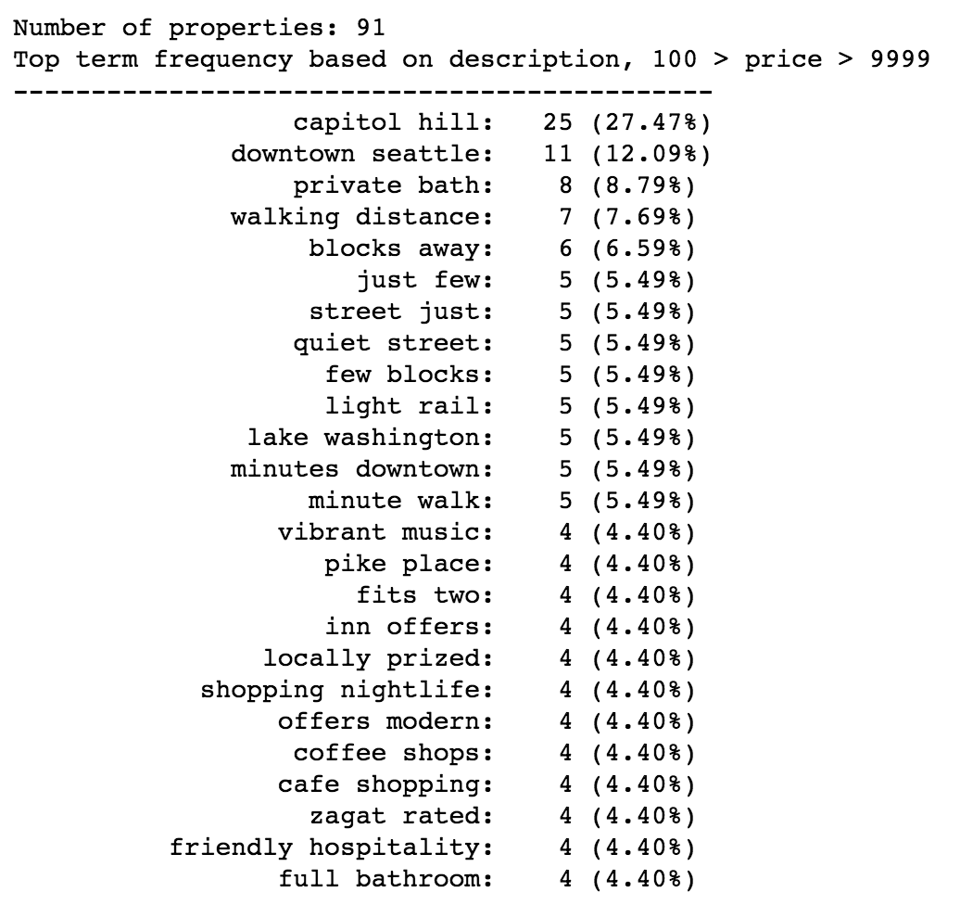
Text Mining

Slide 16
Loftium – Project Overview
Project Scope
Explore Loftium data
Evaluate Loftium’s existing model
Scrape for additional data
Develop alternative predictive models

Slide 17
Loftium – Next Steps
Alternative Questions to Explore:
Customer acquisition predictive model
What customer profiles are most likely to use Loftium’s services?
What property profiles are the best candidates for Loftium’s services?

